Slide 1
EMTH403
Mathematical Foundation for Computer Science

Slide 2
Lecture Outcomes
understand the Division rule in the basics of counting.
understand how to find total number of functions in the basics of counting.

Slide 3
Basics of Counting – The Division Rule
There are n/d ways to do a task if it can be done using a procedure that can be carried out in n ways, and for every way w, exactly d of the n ways correspond to way w.

Slide 4
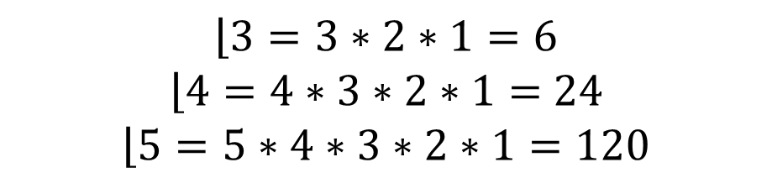
Basics of Counting – The Division Rule
1
2
3
$$\left\lfloor 3=3∗2∗1=6\right.$$
$$\left\lfloor 4=4∗3∗2∗1=\right. 24$$
$$\left\lfloor 5=5∗4∗3∗2∗1=120\right.$$
3
2
3
1
2
1
2
3
123
132
213
231
312
321
1
3
1
2
3
1
2
3
1
2
3
1
2
3 choices, 2 Choices, 1 Choice

Slide 5
Basics of Counting – The Division Rule
3
4
2
4
2
3
4
3
4
2
3
2
1234
1243
1324
1342
1423
1432
Similarly
2134
2143
2314
2341
2431
2413
Similarly
3124
3142
3214
3241
3412
3421
Similarly
4123
4132
4213
4231
4321
4312
2
3
4
1
4choices,3 choices, 2 Choices, 1 Choice
$$4∗3∗2∗1=24=\left\lfloor 4\right.$$

Slide 6



Basics of Counting – The Division Rule
$\frac{\left\lfloor 4\right.}{4}=\frac{4∗3∗2∗1}{4}=3∗2∗1$ = 6
$\frac{\left\lfloor 5\right.}{5}=\frac{5∗4∗3∗2∗1}{5}=4∗3∗2∗1$ = 24
$$\frac{\left\lfloor 7\right.}{7}=\frac{7∗6∗5∗4∗3∗2∗1}{7} =720$$

Slide 7
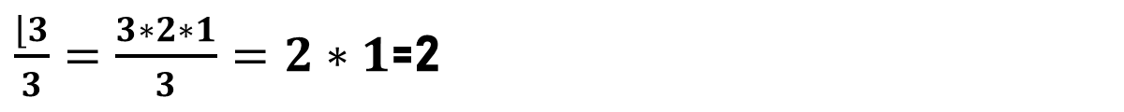
Basics of Counting – The Division Rule
Example: Of the 3!= 6 permutations of three objects, the (3-1)!= 2 distinct circular permutations are {1,2,3} and {1,3,2}.
123
132
213
231
312
321
R
1
L
3
2
=
R
L
=
3
2
2
1
1
3
L
R
$\frac{\left\lfloor 3\right.}{3}=\frac{3∗2∗1}{3}=2∗1$=2

Slide 8
Basics of Counting – The Division Rule
R
1
L
2
3
R
L
123
231
312
132
213
321
=
=
2
3
3
1
1
2
L
R
R
1
L
3
2
=
R
L
=
3
2
2
1
1
3
L
R
$\frac{\left\lfloor 3\right.}{3}=\frac{3∗2∗1}{3}=2∗1$=2

Slide 9
Basics of Counting – The Division Rule
Ques:- How many different ways are there to seat four people around a circular table, where two seating's are considered the same when each person has the same left neighbor and the same right neighbor?
Ans:- There are 4! = 24 ways to order the given four people for these seats.
Because there are four ways to choose the person for seat 1, by the division rule there are "24" /4 = 6 different seating arrangements of four people around the circular table.

Slide 10
Basics of Counting – The Division Rule
1
1
1
1
4
2
2
4
3
2
2
3
3
3
4
4
Repeated
2134
2143
2314
2341
2431
2413
Repeated
3124
3142
3214
3241
3412
3421
Repeated
4123
4132
4213
4231
4321
4312
1
1
1234
1243
1324
1342
1423
1432
4
3
3
4
2
2

Slide 11
Basics of Counting – The Division Rule
f
a
A
b=f(a)
B
f
The function f Maps A to B

Slide 12
Different Types of Correspondences
A
B
C
D
1
2
3
An Onto function

Slide 13
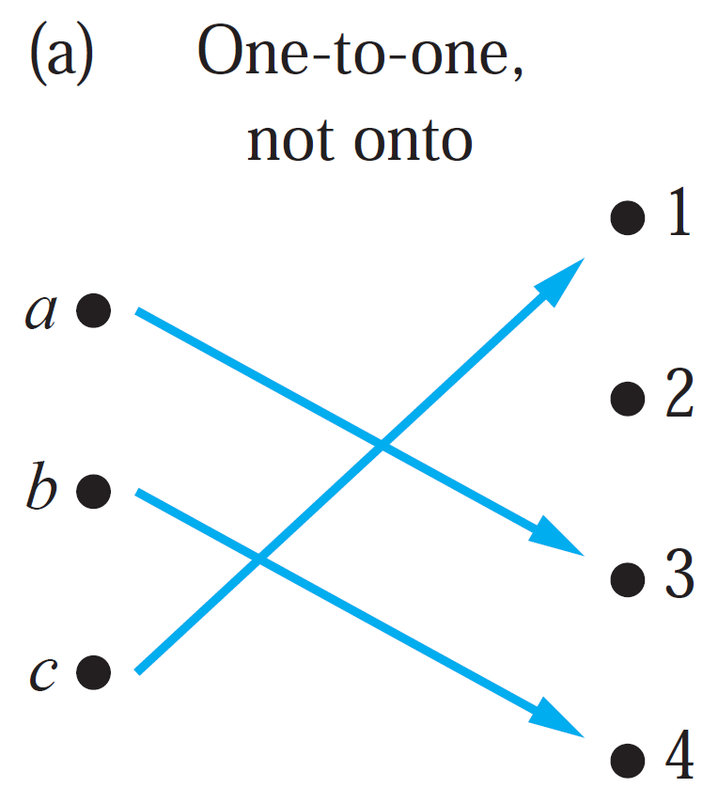
Different Types of Correspondences

Slide 14
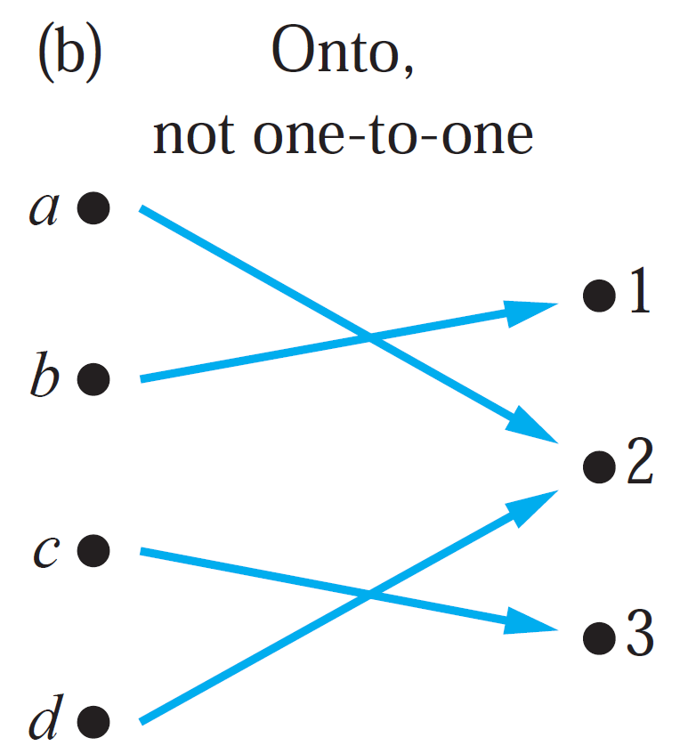
Different Types of Correspondences

Slide 15
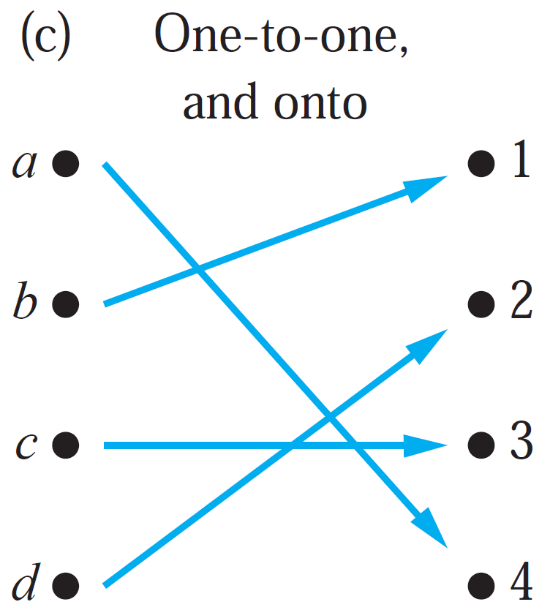
Different Types of Correspondences

Slide 16
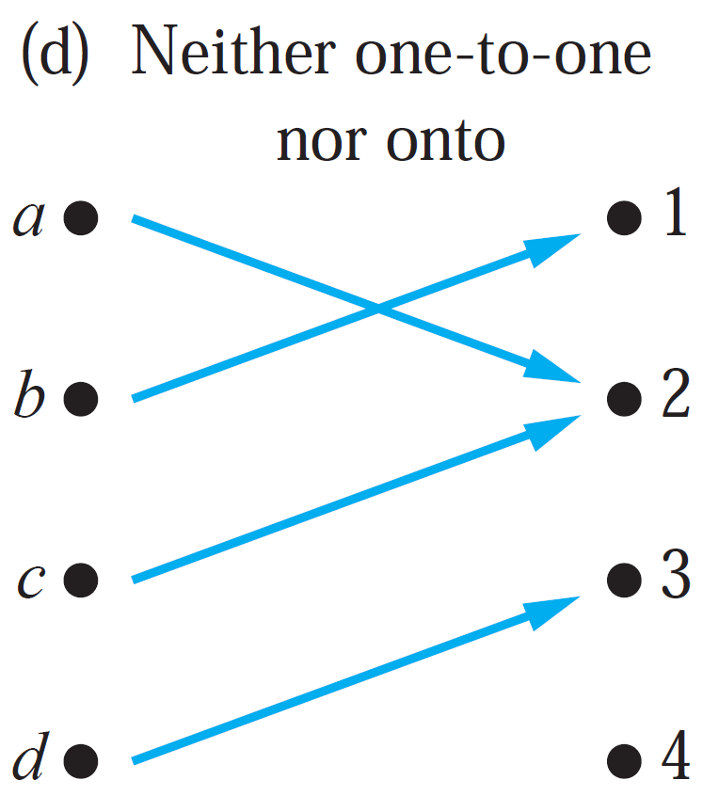
Different Types of Correspondences

Slide 17
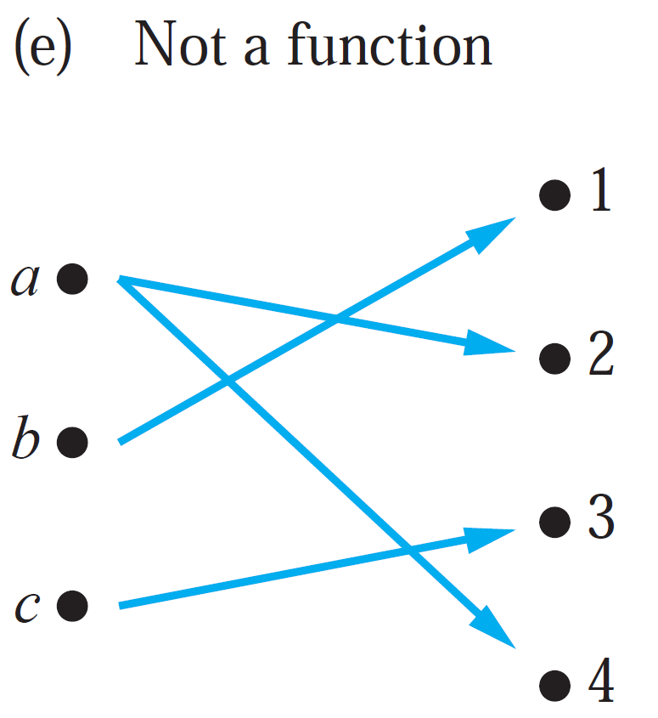
Different Types of Correspondences

Slide 18
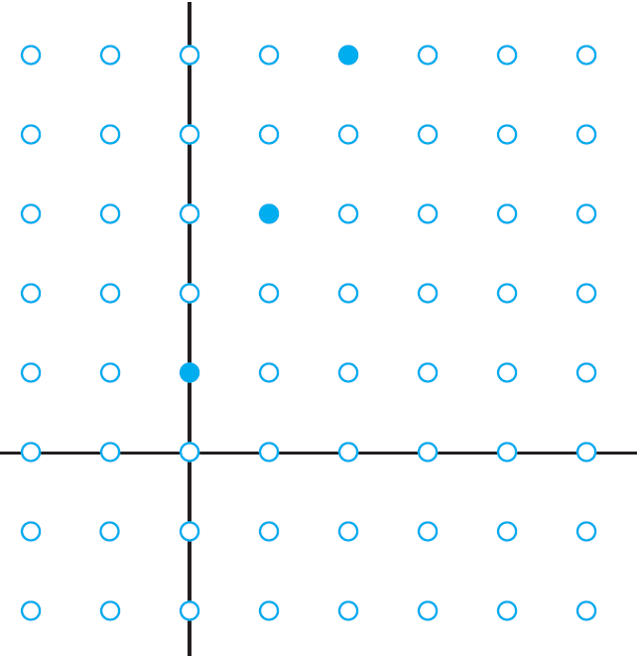
Function - Example
n
0
1
2
3
2n+1
1
3
5
7
The Graph of f (n) = 2n + 1 from Z to Z.

Slide 19
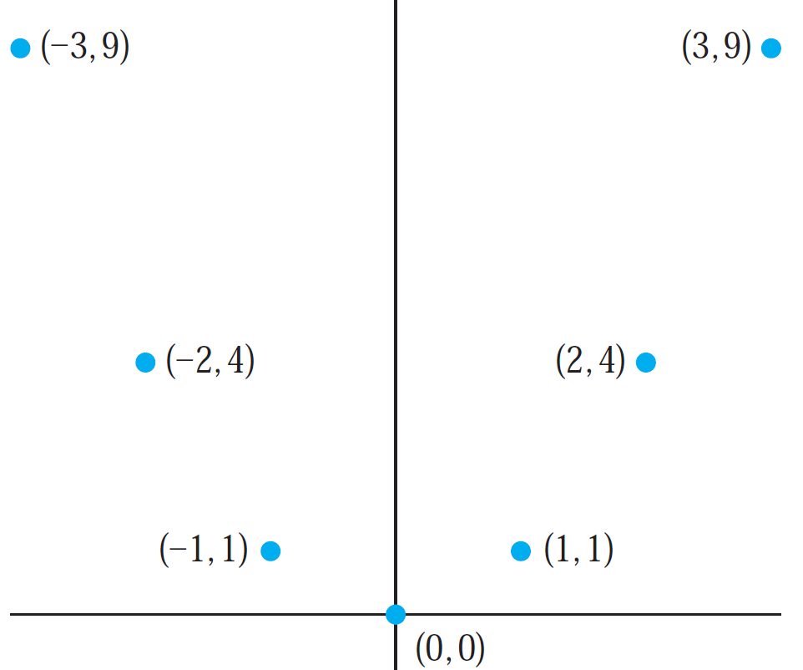
Function - Example
x
3
-2
-1
0
1
2
3
x²
0
1
4
9
The Graph of f (x) = x² from Z to Z.

Slide 20
Counting Functions
Ques:- How many functions are there from a set with m elements to a set with n elements?
Ans:- By the product rule there are n · n · · · · · n = n^{m} functions from a set with m elements to one with n elements.
For example, there are 5³ = 125 different functions from a set with three elements to a set with five elements.

Slide 21
Counting Functions
5 Choices
5 Choices
5 Choices
A
B
C
1
2
3
4
5
There are 5³ = 125 different functions from a set with three elements to a set with five elements.

Slide 22
Counting Functions
Ques:- How many functions are there from a set with 4 elements to a set with 5 elements?
Ans:- There are 5⁴ = 625 different functions from a set with four elements to a set with five elements.

Slide 23
Counting Functions
5 Choices
5 Choices
5 Choices
5 Choices
A
B
C
D
1
2
3
4
5
There are 5⁴ = 125 different functions from a set with four elements to a set with five elements.

Slide 24
Counting Functions
N Choices
N Choices
N Choices
N Choices
…….
N Choices
A
B
C
D
…..
M
1
2
3
4
5
….
N
There are M^{N} different functions from a set with N elements to a set with M elements.

Slide 25
Counting One-to-One Functions
Ques:- How many one-to-one functions are there from a set with m elements to one with n elements?
Ans:- By the product rule, there are
n(n − 1)(n − 2) · · · (n − m + 1) one-to-one functions from a set with m elements to one with n elements.
For example, there are 5 · 4 · 3 = 60 one-to-one functions from a set with three elements to a set with five elements.

Slide 26
Counting One-to-One Functions
Cannot Repeat in 1-1 Mapping/Function
5 Choices
4 Choices
3 Choices
A
B
C
1
2
3
4
5
There are 5 · 4 · 3 = 60 different functions from a set with three elements to a set with five elements.

Slide 27
Counting One-to-One Functions
N Choices
N-1 Choices
N-2 Choices
N-3 Choices
…….
N-(M-1) Choices
A
B
C
D
…..
M
1
2
3
4
5
….
N
There are N(N − 1)(N − 2) · · · (N − M + 1) different functions from a set with N elements to a set with M elements.

Slide 28
Counting One-to-One Functions
Cannot Repeat in 1-1 Mapping/Function
5 Choices
5-1 Choices
5-2 Choices
A
B
C
1
2
3
4
5
There are 5 · (5-1) · (5-2) = 5 · 4 · 3 = 60 different functions from a set with three elements to a set with five elements.

